Slide 1
Persistent Organic Pollutant
By Sarah, Chantal, Marie and Zakaria

Slide 2
Introduction

Slide 3
What are POPs?
POP = Persistent Organic Pollutant, chemical substances that persist the environment.
Bioaccumulation through food + negative effects on human health and environment.
Example of POP: Pesticides (DDT), industrial pollutants (polychlorinated biphenyls, PCBs) and unintentional by-products of industrial process (dioxins and furans).
Risk all over the globe due to transportation over the borders and to landscapes where there have never been present, such as in the Arctic.

Slide 4
International Regime for POPs

Slide 5
Two pieces of legislation
The Protocol to the regional UNECE Convention on Long-Range Transboundary Air Pollution (CLRTAP) on POPs
“Aarhus Protocol”
Stockholm Convention on Persistent Organic Pollutants

Slide 6
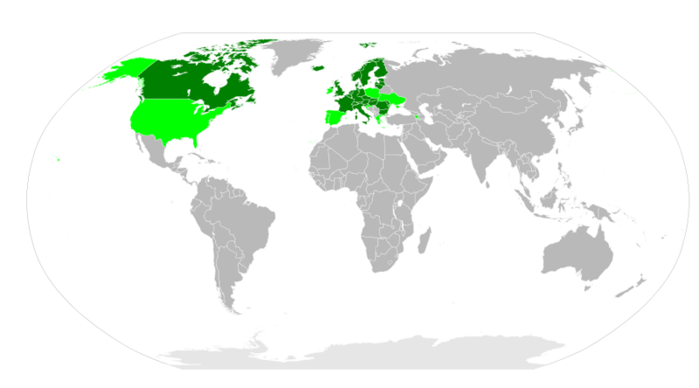
Aarhus Protocol
Signed in 1998 & entered into force 2003
32 states plus the EU have signed and ratified
6 have signed but not ratified
Objective: “to control, reduce or eliminate discharges, emissions and losses of persistent organic pollutants” (Article 2)
16 substances singled out
includes pesticides, industrial chemicals and by-products/ contaminants
Amendments made in 2009 added 7 new substances

Slide 7
Aarhus Protocol
Article 3 - basic obligations
Article 4 - exemptions
Annex I - eliminated substances
Annex II - restricted substances
conditions for production and use
usually related to public health or recycling

Slide 8
Stockholm Convention
signed in 2001 and entered into force in 2004
179 parties to the convention (178 states + EU)
US,Iraq, Greenland, Italy and others
Objective: ‘to protect human health and the environment from persistent organic pollutants’ - Article 1
Annex A - eliminated substances
Annex B - restricted substances
Article 3 - Intentional Production and Use
prohibit production and use of Annex A
Restrict prohibition and use of Annex B
Import and Export

Slide 9
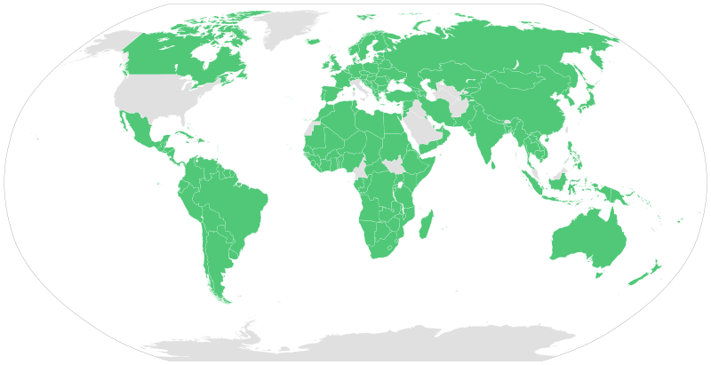

Slide 10
Stockholm Convention
signed in 2001 and entered into force in 2004
179 parties to the convention (178 states + EU)
US,Iraq, Greenland, Italy and others
Objective: ‘to protect human health and the environment from persistent organic pollutants’ - Article 1
Annex A - eliminated substances
Annex B - restricted substances
Article 3 - Intentional Production and Use
prohibit production and use of Annex A
Restrict production and use of Annex B
Import and Export

Slide 11
Stockholm Convention
Article 4 - Register of Specific Exemptions
Parties have to apply
public register
in additions to conditions in Annexes
Exemptions last 5 years - expiry
Article 5 - Unintentional production
action plan
Article 6 - Handling of waste
identify stockpiles and manage them

Slide 12
EU Legislation

Slide 13
EU Legislation
Additionally to the 15 MS, EU signed both the Convention and the Protocol
Implementation Measure: Regulation No 850/2004 of the European Parliament and of the Council of 29 April 2004
on persistent organic pollutants and amending
Directive 79/117/EEC
The Regulation is binding and directly applicable in all MS.

Slide 14
EU Legislation
New chemicals added in 2010 to implement the agreement reached at the 4th Conference of the Parties to the Stockholm Convention in 2009:
Certain of those have mainly been used in consumer products, whereas the original chemicals in the regulation were mostly pesticides.
Art. 14 of the Regulation obligates the Commission, where appropriate, to amend Annexes I to III if a substance is listed in the Protocol or the Convention.
Ensures actions accordingly to the Precautionary Principle.

Slide 15
EU Legislation
Article 3: Control of production, placing on the market and use
Article 4: Exemptions
Art. 3 does not apply in case of use for laboratory-scale research or as a reference standard
or if the substances occur as an unintentional trace contaminant in substances, preparations or articles.
Art. 5: Stockpiles of substances shall be treated as waste, management in an environmentally sound manner.

Slide 16
EU Legislation
Art. 6: Release reduction, minimisation and elimination
Release Inventories for substances listed in Annex III for each MS
Action plan: Measures for development and if appropriate, use of substitute materials.
Art. 9: Monitoring
Art. 10: Information exchange
→ “Information on health and safety of humans and the environment shall not be regarded as confidential”

Slide 17
EU Legislation
Article about POP intake due to fish consumption:
“Public health concern behind the exposure to persistent organic pollutants and the risk of metabolic diseases”
Jérôme Ruzzin
BMC Public Health 2012, 12:298.http://www.biomedcentral.com/1471-2458/12/298

Slide 18
EU Legislation
Art. 13: Penalties
“MS shall lay down the rules on penalties applicable to infringements of the provision of this Regulation and shall take all measures necessary to ensure that they are implemented.”
Notifying the Commission about the provisions.

Slide 19
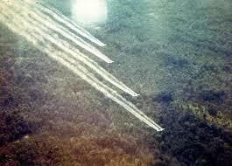
The Aerial Herbicide Spraying (Ecuador v Colombia) case

Slide 20
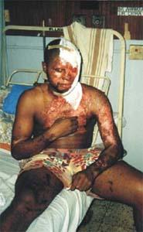
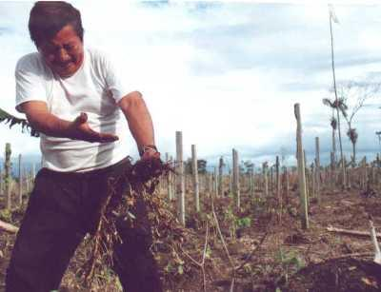
Background
Aerial Herbicide Spraying: Practice of realising subtances toxic to plants to destroy unwanted vegetation (illegal coca, poppy plantations)

Slide 21
Background
2000: Colombia begun spraying herbicides across the Colombian-Ecuadorian border to manage unwanted vegetation (illegal coca, poppy plantations)
2008: Ecuador filed complaints before ICJ, claiming that Colombia’s herbicide harmed Ecuadorian people, property and environment
2011: Extention of the time limit alloted to file the Rejoinder of the Republic of Colombia
2013: Removal from the ICJ’s list of the Aerial Herbicide Spraying case at the request of Ecuador, following an agreement resolving the present dispute

Slide 22
The Agreement of 9 September 2013
It “establihes, inter alia, an exclusion inter alia, an exclusion zone, in which Colombia will not conduct aerial spraying operations, creates a Joint Commission to ensure that spraying operations outside that zone have not caused herbicides to drift into Ecuador and, so long as they have not, provides a mechanism for the gradual reduction in the width of the said zone; according to the letters, the Agreement sets out operational parameters for Colombia’s spraying programme, records the agreement of the two Governments to ongoing exchanges of information in that regard, and establishes a dispute settlement mechanism”.

Slide 23
The Agreement of 9 September 2013
Its advantage:
- to prove that States are able to resolve their disputes peacefully
Its disadvantages:
- to prevent the ICJ from deciding the case and developing its jurisprudence regarding transbondory environment damages
- no mention about an obligation for Colombia to pay penalties or compensations for the harmful impact of its aerial herbicide spraying on Ecuadorian environment and people

Slide 24
POPs in the Arctic

Slide 25
The Arctic Indigenous population
•Population: around 4 millions
•Old civilization
•Different ethnical groups
•No single government
•The Arctic Council (1996)

Slide 26
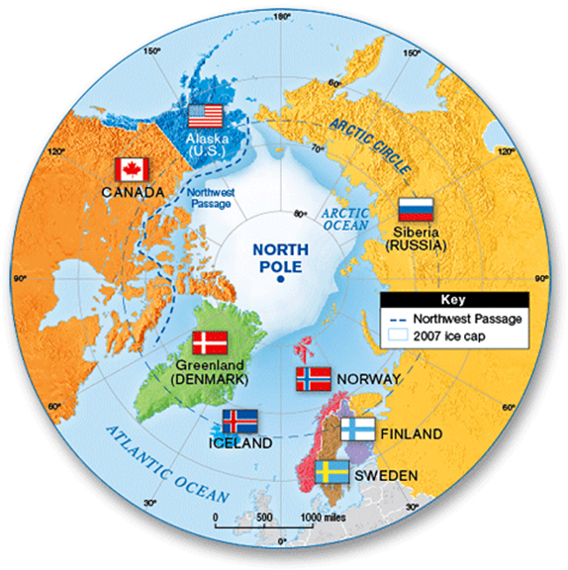
The Arctic

Slide 27
The Arctic and the POPs
•Primarily challenges due to climate change and global contaminants.
•Direct impact on environment and health.
•High accumulation of POP’s in the Northern Latitude.
•Reason: mostly from air due to winds and oceans.

Slide 28
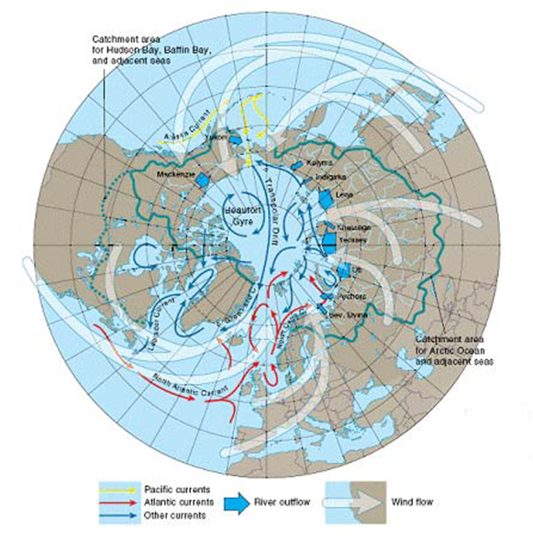
Movement of POPs to the Arctic

Slide 29
Impact on the ecosystem
•These chemicals affect the health of animals and humans.
•POPs present a significant hazard to the health and cultures of Indigenous Peoples of the Arctic due to their impact on the population’s diet.
•Levels of certain POPs can be significantly higher in traditional food such as fish and marine mammals than in market foods.
•In many cases, there is no alternative to the subsistence way of life of Arctic Indigenous Peoples due to lack of a cash based economy.
>In other words, the ecosystem is generally affected which causes logically severe consequences.

Slide 30
“How could the Arctic, seemingly untouched by contemporary ills, so innocent, so primitive, so natural, be home to the most contaminated people on the planet? I had stumbled upon what is perhaps the greatest environmental injustice on Earth.”
Marla Cone, Silent Snow: The Slow Poisoning of the Arctic (Grove Press, New York, 2005)

